Slide 1


Developing Data Warehousing & Business Intelligence System
MIS 636 - B
CITI BIKE
Team E Members:

Slide 2
Contents
Company Profile
Business Dimensional Lifecycle
High Level Bus Matrix
Opportunity Matrix
Prioritization Grid
Detailed Bus Matrix
Dimensional Modeling – Steps
Logical Fact Table Diagram
Detailed Fact Table
High Level Model Diagram
Aggregate Table
Dimensions Attribute Detailed Description
OLAP Cube Design
Representation Using Tableau
User/Task Analysis
Conclusion
© 2015 Stevens Institute of Technology

Slide 3
Company Profile
Citi Bike is New York City's bike sharing system. Intended to provide New Yorkers and visitors with an additional transportation option for getting around the city, bike sharing is fun, efficient and convenient.
A bike sharing system consists of a fleet of specially designed, sturdy, very durable bikes that are locked into a network of docking stations sited at regular intervals around a city. The bikes can be rented from and then returned to any station in the system, creating an efficient network with many possible points and combinations of departure and arrival.
With thousands of bikes at hundreds of stations, Citi Bike is available for use 24 hours a day, all year 'round. The station network provides twice as many docking points as bicycles, assuring that an available dock to return your bike is always nearby.
Citi Bike is operated by NYC Bike Share LLC, a wholly-owned subsidiary of Motivate. Motivate is a unique company focused solely on operating large-scale bike share systems.
© 2015 Stevens Institute of Technology

Slide 4
Business Dimensional Lifecycle
High Level Enterprise Data Warehouse Bus Matrix
Technology Track
Business
Requirements
Definition
Technical
Architecture
Design
Product
Selection &
Installation
Data Track
Project
Planning
Dimensional
Modeling
Physical
Design
Data Staging
Design &
Development
Deployment
Maintenance
& Growth
Application Track
End-User
Application
Development
End-User
Application
Specification
Project Management
Notes:
Project Planning – Scope of the project is defined
Business Requirements Definition – What are the Questions that the business needs to get answered, Detail Requirements Gathering
In our example the Company OrgX wants to know which clients are more profitable than others, How much do the employees cost us and do we have optimum utilization of our resources.
Dimensional Modelling – We build the Bus Matrix b
4

Slide 5
High Level Bus Matrix
Business Process | Time | Station | User_Details | Bicycle | Rental | Employee
On-Line Sales Transactions | x | x | x | x | x
Sales Transactions at the bike docking station | x | x | x | x | x | x
Vendor Sales Transaction | x | x | x |  | x
Return Policy | x | x | x | x |  | x

Slide 6
Opportunity Matrix
Business Process | Customer Services | Finance | Operations | Marketing | Logistics | Strategy Management
On-Line Sales Transactions | x | x | x | x | x | x
Sales Transcations at the bike docking station | x | x | x | x | x | x
Vendor Sales Transaction | x | x |  | x | x
Trip processing | x |  | x
Return Process | x |  | x |  | x

Slide 7
Prioritization Grid

Slide 8
Detailed Bus Matrix
Business Process | Fact Tables | Granularity | Fact | Time | Station | User Details | Bicycle | Rental | Employee
On-Line Sales Transactions | Sales Transactions | Per hour | Purchase date key Purchase amount key purchase unit price key Transcation Number | x |  |  | x | x
 |  |  |  | x |  | x |  | x
 |  |  |  | x |  | x | x
Sales Transactions at the bike docking station | Bicycle fact | Per hour | Bicycle_Fact_ID(SK) Bicycle_ID(FK) User_ID(FK) Rental_ID(FK) Bicycle_SK(FK) Station_ID(FK) Trip_ID(FK) Time(FK) | x | x | x | x | x
 | Billing and Invoicing | Per hour | date key order Number quantity Key Product Key | x |  | x | x | x | x
 |  |  |  | x |  | x | x
Vendor Sales Transacation | vendor sales |  | Purchase date key Purchase amount key purchase unit price key Transcation Number | x |  | x |  | x
 |  |  |  | x |  | x |  | x
Return Policy | return transactions | per hour | Return key User_ID Bicycle_ID Time | x | x | x | x |  | x
 | lost_damage_fact | per lost key | Lost key | x | x | x | x |  | x
 |  |  | User_ID
 |  |  | Bicycle_ID

Slide 9
Ansoff Matrix for Opportunities - Sales
Product
Market penetration
Product development
Easiest way to grow in a expanding market.
Can be increased by developing new applications.
Improved efficiency and no down time would be a great benefactor
Increased data analytics of the customers wants and needs.
This helps in the change of modifying the needs to the consumer.
Market
Market development
Diversification
BI tools to have a deeper insight into what consumer wants.
Tracking the condition and performance of these assets.
New partners, new technologies, new assets and new data streams are formed.
Asset monitoring helps to transform the business models.

Slide 10
Steps To Dimensional Modelling
Choose a Business Process and its data
A Business Process is chosen as a fact table.
OrgX – Bicycle-Renting Process
Choose the Grain of the Business Process
Represents one row of the Fact Table.
Choose the lowest possible grain, aggregate to higher levels.
OrgX – Each Customer, Time in the Fact table
.Choose Dimensions of the Business Process
Dimensions explain Fact tables.
Represent Query Entry-Points into the Star Schema.
Each Dimension has several Attributes.
OrgX – Time, User, Rental, Bicycle
Choose the measured Facts
Facts are numeric fields that populate each fact table record.
OrgX – Bike Rented, User who has rented, stations, duration of bike usage

Slide 11
Logical Fact Table Diagram

Slide 12
Detailed Fact Table
Bicycle Fact Table
Bicycle_Fact_ID(SK)
Bicycle_ID(FK)
User_ID(FK)
Rental_ID(FK)
Bicycle_SK(FK)
Station_ID(FK)
Trip_ID(FK)
Time(FK)
Description

Slide 13
High End Data Model
Bicycles
Trip details
User Details
Bicycle-Renting Fact
Bicycle usage
Rentals
Time
Payment
Bicycles in Station

Slide 14
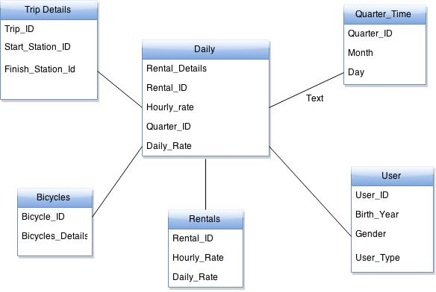
Aggregate Table

Slide 15
Dimensional Table Detailed Diagram: Trip Details table
Bike
(34176)
(324)
Start Station Longitude
Start Station Latitude
End Station Latitude
End Station Longitude
(324)
(324)
(324)
(324)
Start Station Name
Start Station ID
(324)
End Station ID
End Station Name
(324)
(324)
Slowly Changing Dimensions Start Station Name End Station Name
Trip
(34176)

Slide 16
Dimensional Table Detailed Diagram: Trip Details table
Attribute Name | Attribute Description | Cardinality | Slowly chaging dimensions policy | Sample Values
Trip ID | The Trip ID is the ID associated | 34176 | Type-0: No Action | 1187221 (7 digit number)
Start Station ID | Each station is associated with an ID | 324 | Type-0: No Action | 164 (3 digit number)
Bike Usage ID | This is the bike usage ID. This is same as the number of trips. Number of times bikes used is directly proportional to the number of trips | 34176 | Type-0: No Action | 3423556
Start Station Name | Each station has specific name | 324 | Type-2: Overwrites | E 47 St & 2 Ave
End Station Name | Each station has specific name | 324 | Type-2: Overwrites | 1 Ave & E 15 St
Start Station Latitude | Each Station has specific latitude | 324 | Type-0: No Action | 40.75323098
Start Station Longitude | Each Station has specific longitude | 324 | Type-0: No Action | -73.97032517
End Station Latitude | Each Station has specific latitude | 324 | Type-0: No Action | 40.73221853
End Station Longitude | Each Station has specific longitude | 324 | Type-0: No Action | -73.98165557

Slide 17

Citi Bike’s Cube
Sex
Unknown
Female
Male
2015
Year-2015
2014
2013
Upper
Midtown
Manhattan Region
Lower

Slide 18
Citi Bike’s Cube – Drill Down
Unknown
Sex
Female
Male
Q1
Year-2015
Q2
Q3
Upper
Midtown
Manhattan Region
Lower

Slide 19



Citi Bike’s Cube - Slicing & Dicing
Unknown
Male
Female
Male
2015
Male
2014
2015
2015
2013
Upper
Upper
Midtown
Upper
Lower
Midtown
Lower

Slide 20
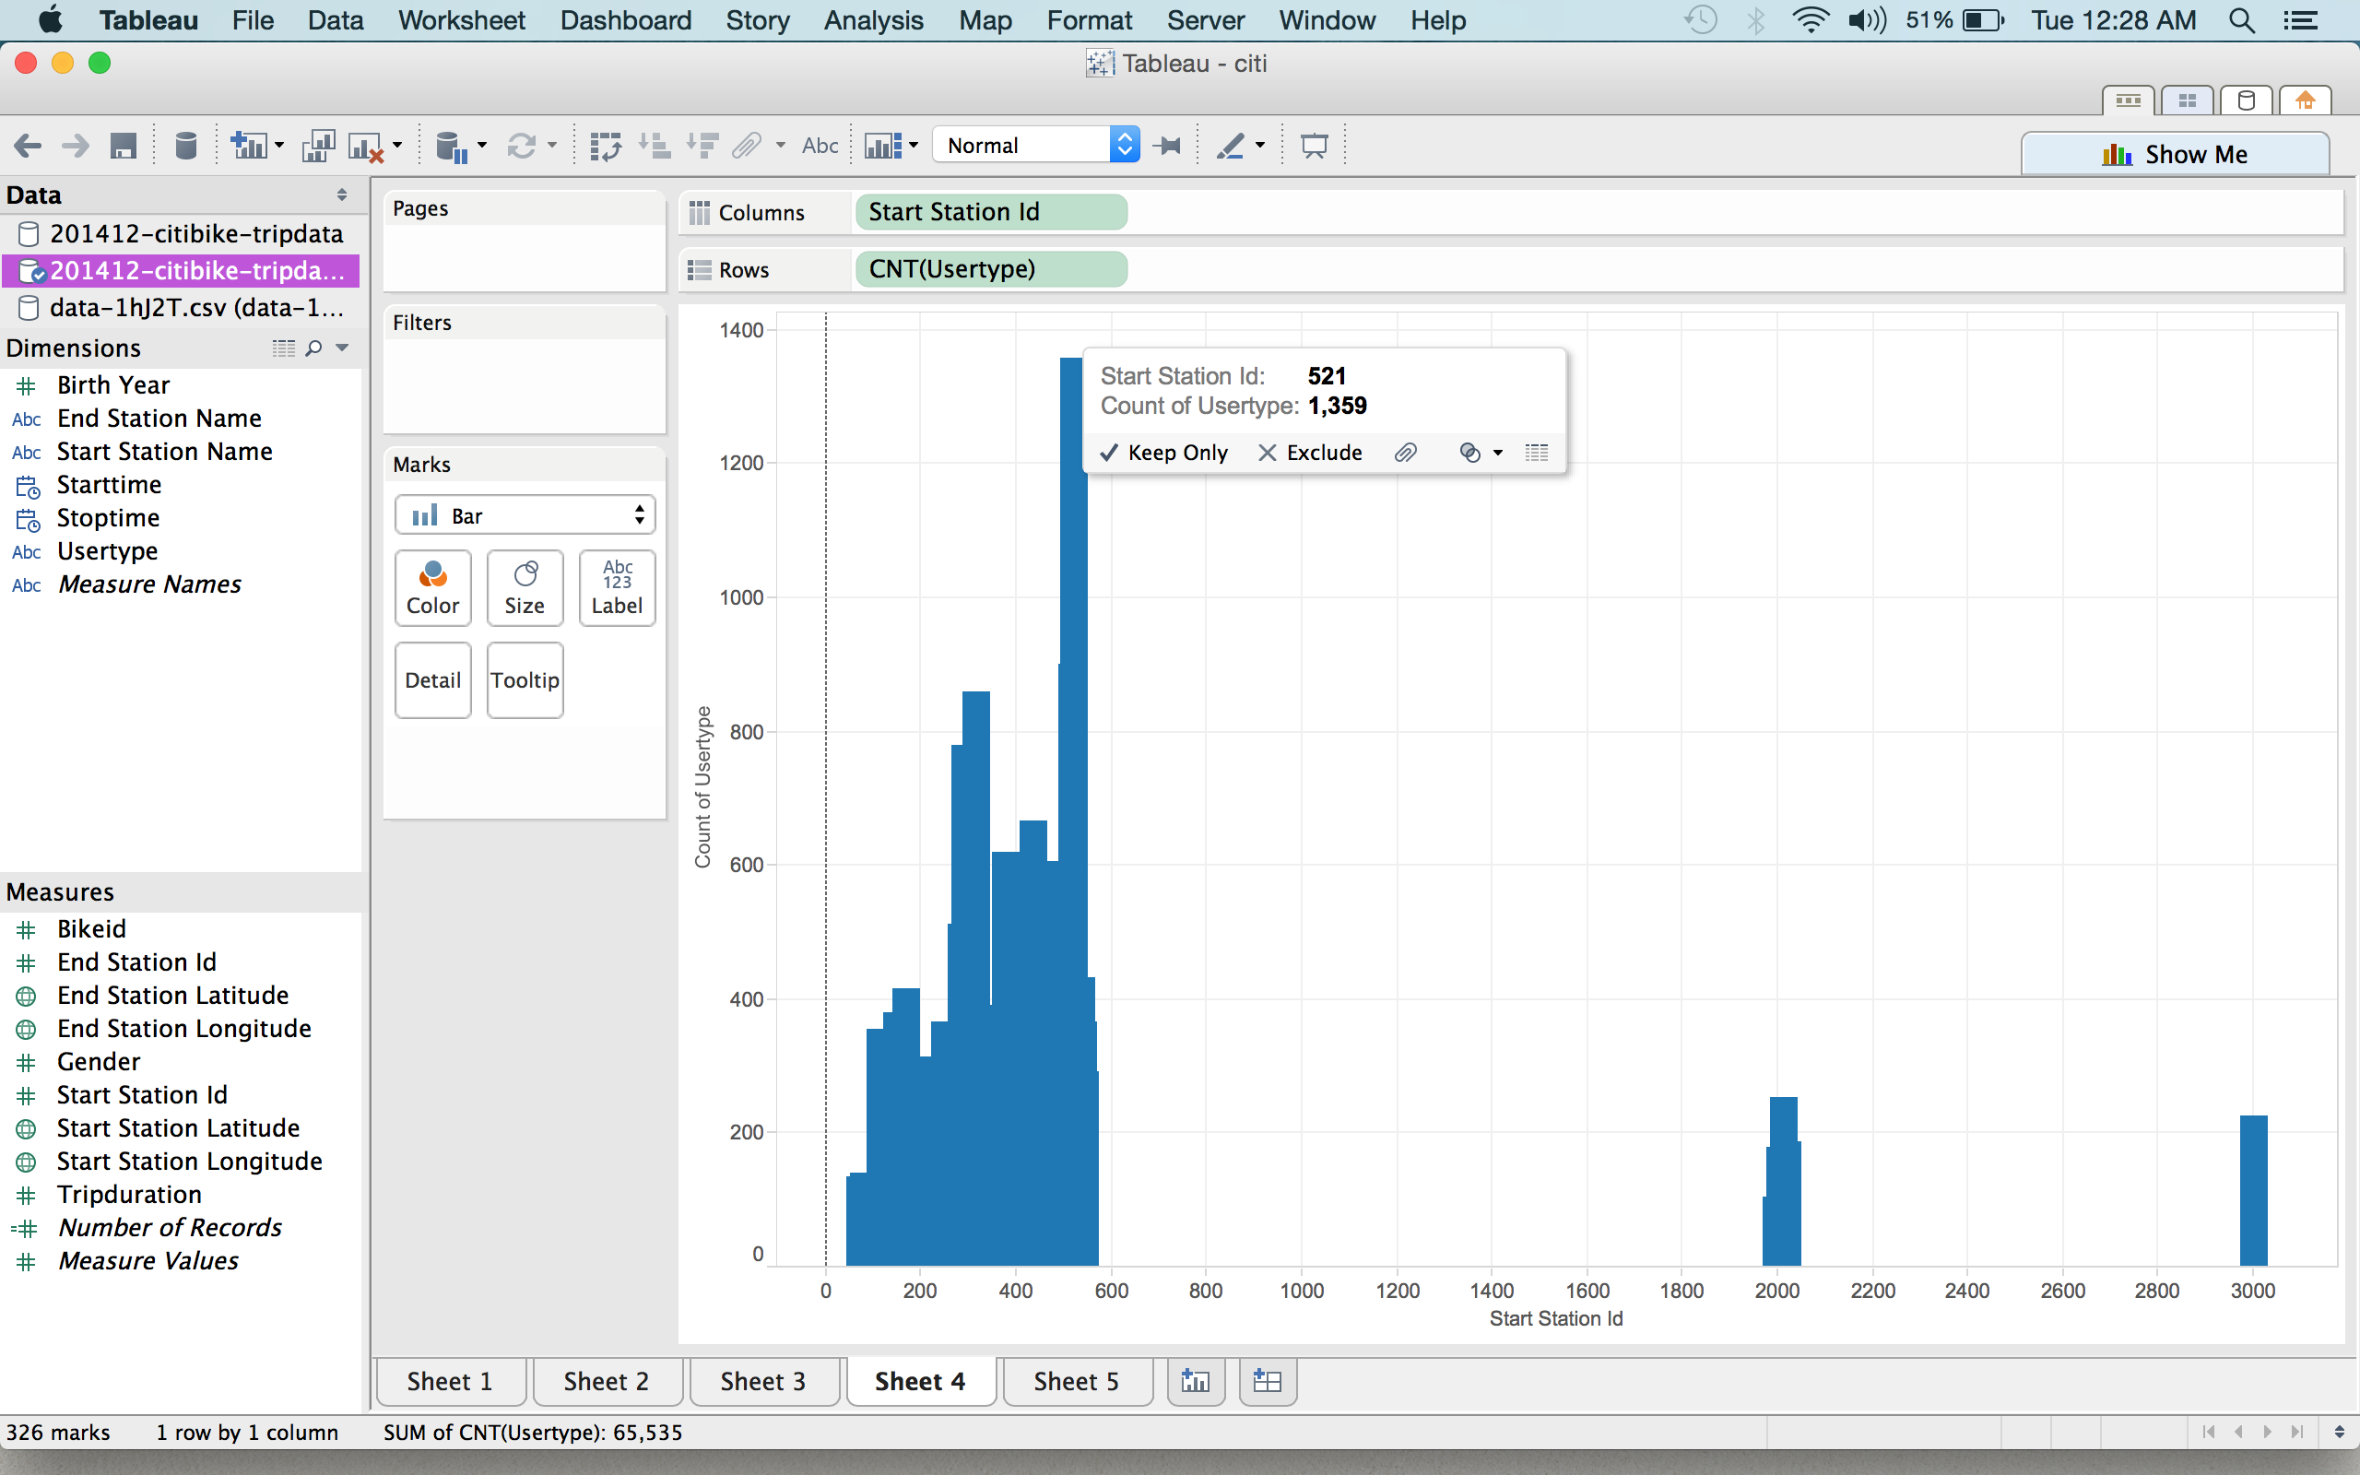
BI Portals and Dashboards

Slide 21
BI Portals and Dashboards(Cont’d)
From the above visualization we can infer that station ID 521 is located at 8 Ave & W 31st street.
As the station also happens to be one of the largest stations consisting of 67 docks, majority start their trip as there are more bikes available as compared to nearby stations.
The above station is also located close to the 33rd street PATH station as well as the subway station which many take, those coming from Uptown, New York or New Jersey to their respective offices or tourist locations in Midtown, New York.
This happens to be the most used start station with 1,359 customers for the month of December 2014.

Slide 22
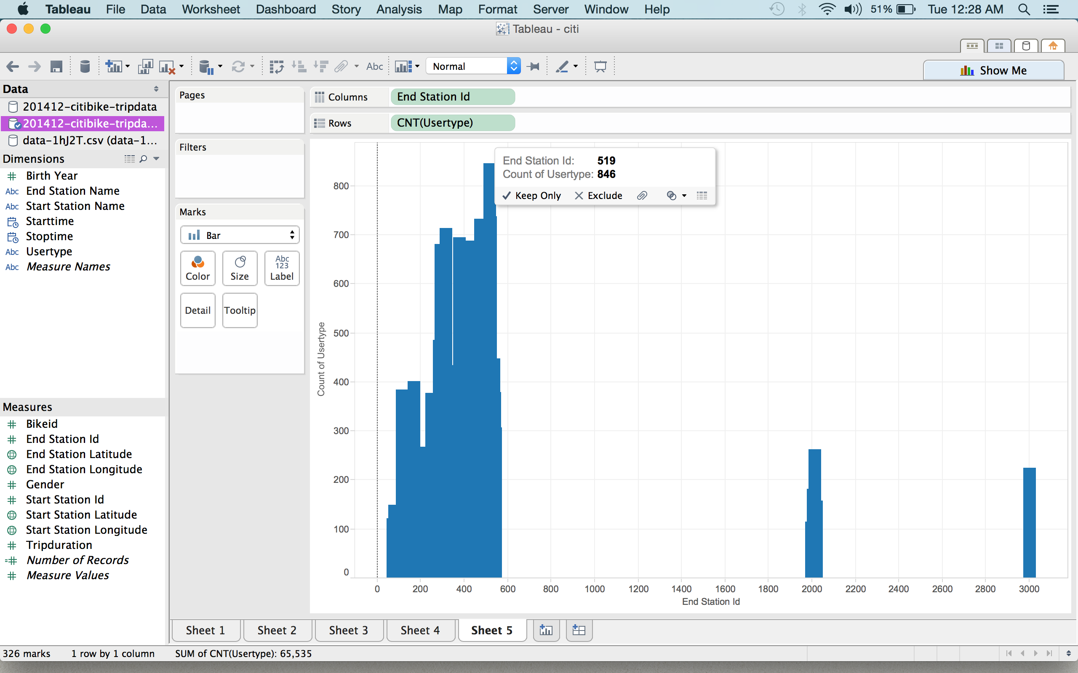
BI Portals and Dashboards

Slide 23
BI Portals and Dashboards(Cont’d)
From the above visualization we can infer that End Station ID 519 is located at Pershing Square North, New York.
As the station also happens to be one of the largest stations consisting of 61 docks, majority end their trip as there are more empty docks available as compared to the nearby stations.
This happens to be the most used end station with 846 customers for the month of December 2014.

Slide 24
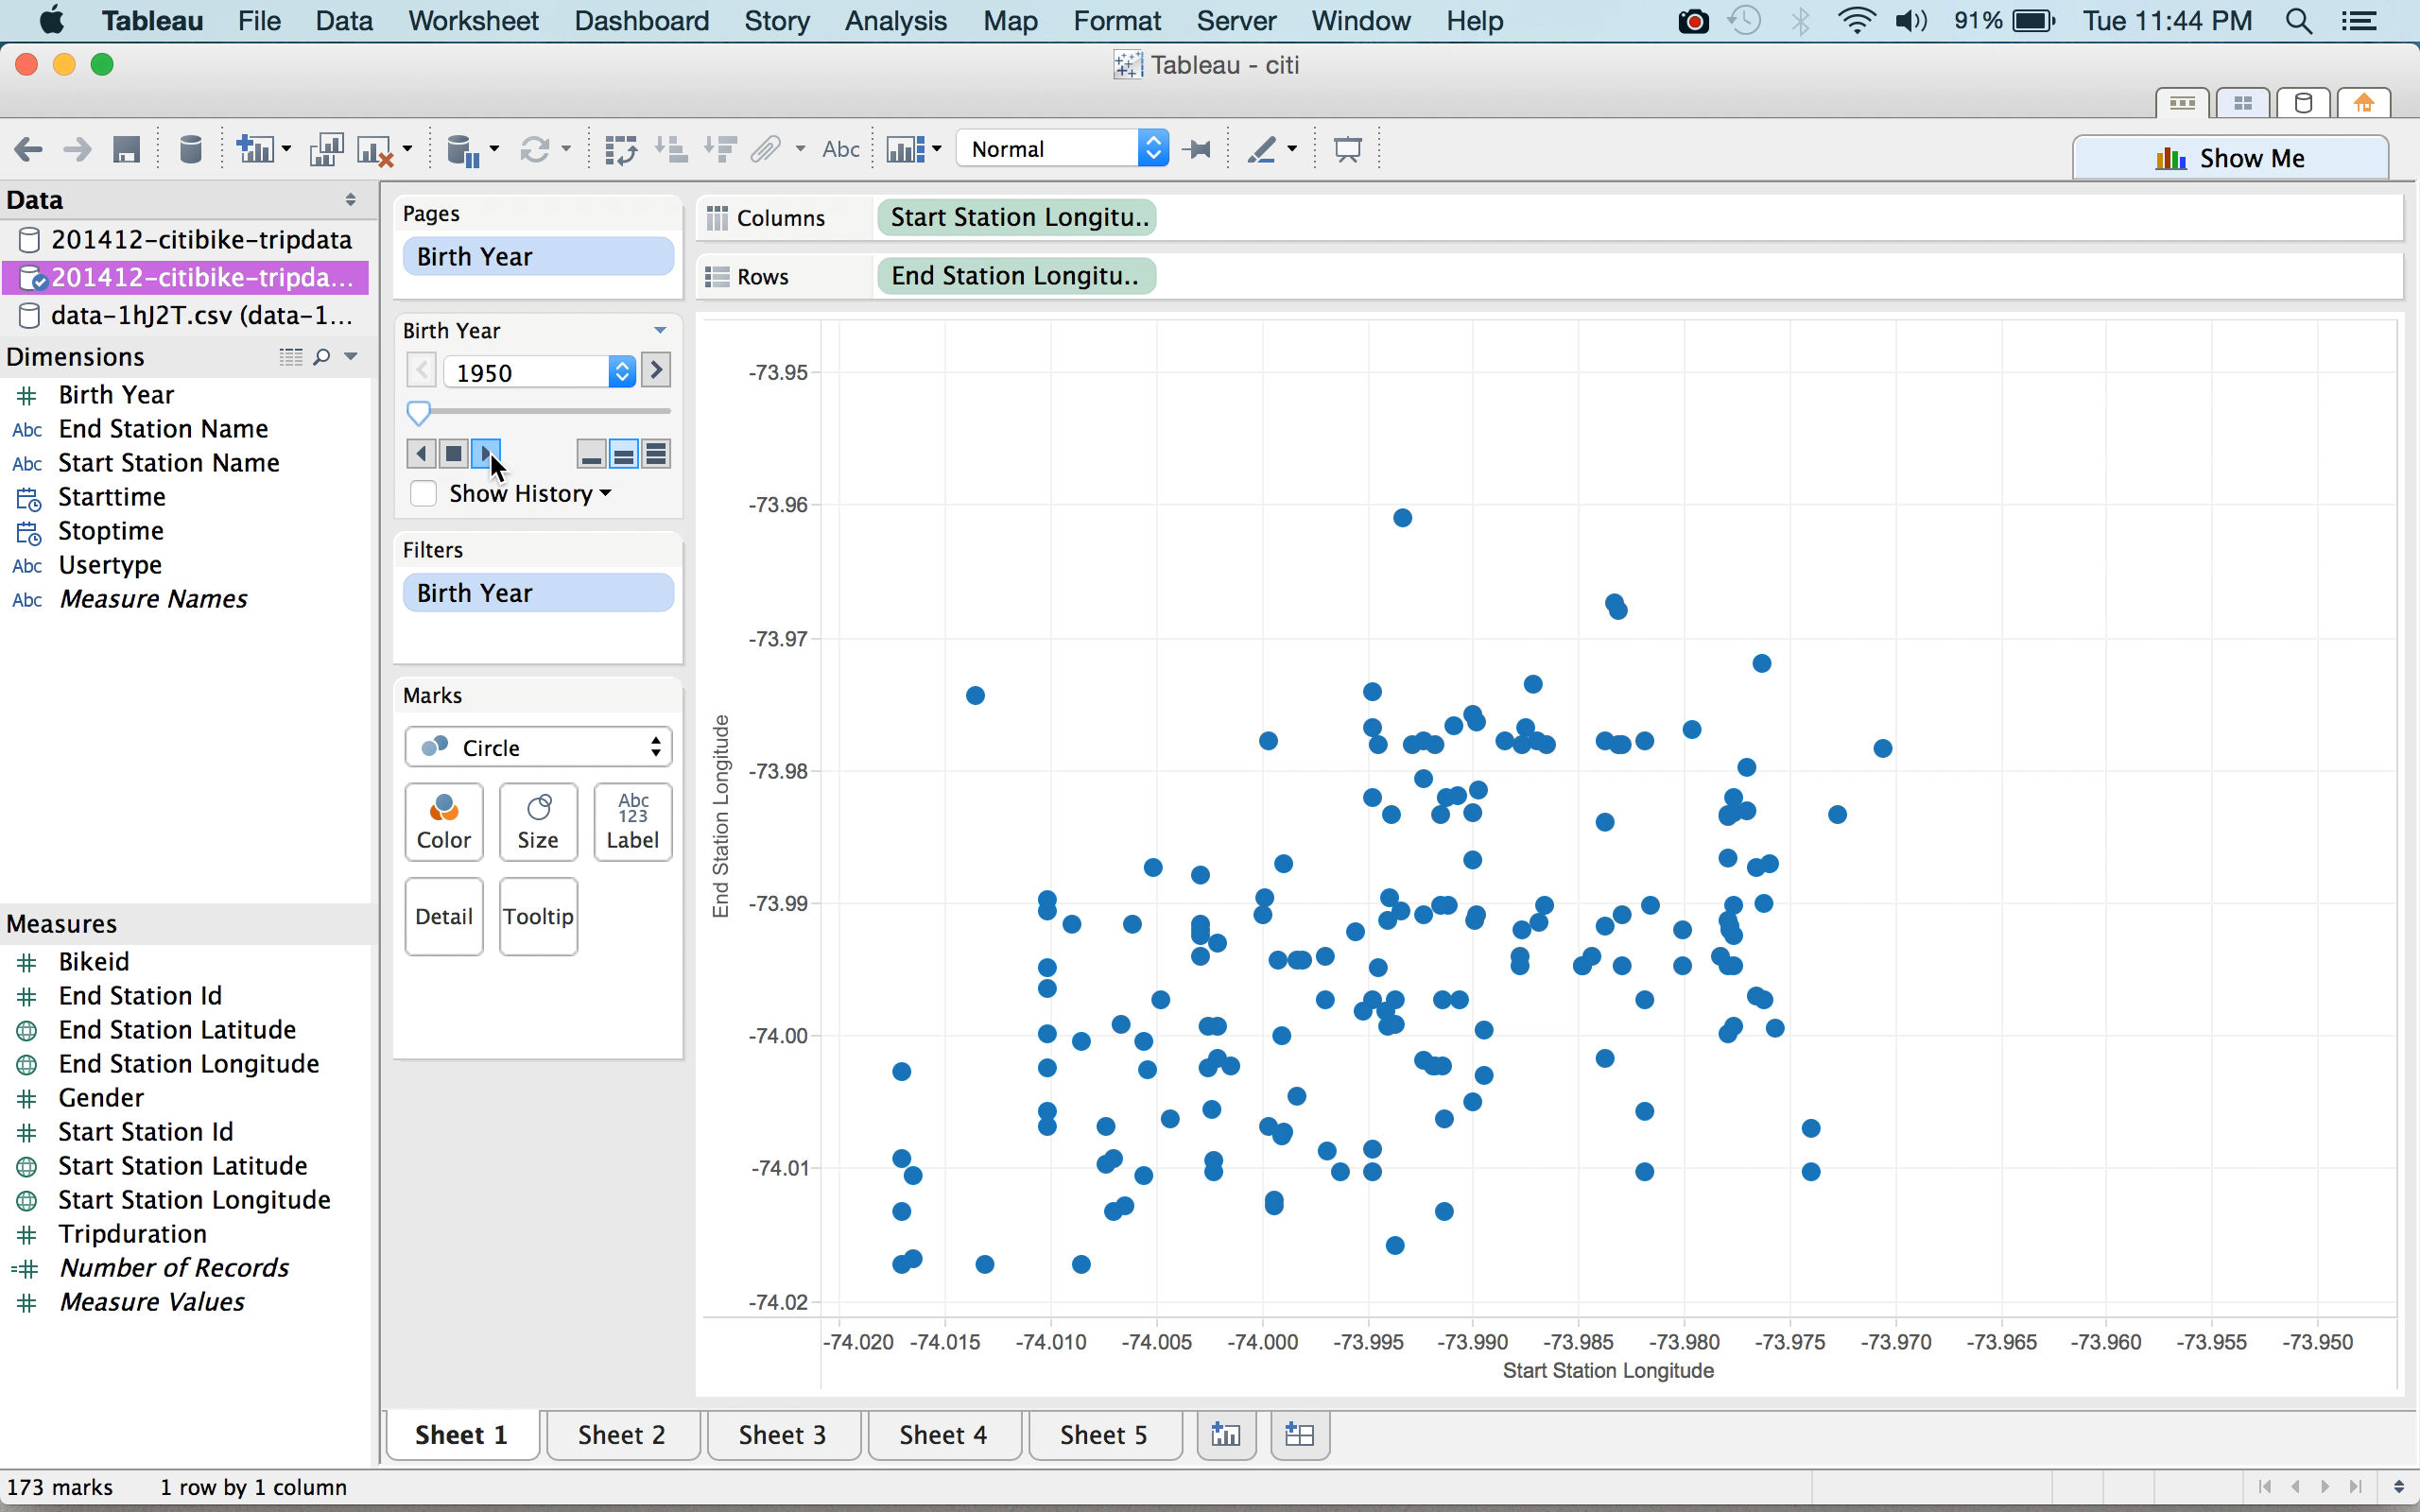
BI Portals and Dashboards(Cont’d)

Slide 25
User & Task Analysis
Power Users:
Stakeholders, Business Analyst
Value:They take decision based on values derived such as renting success ratio, bike service effectiveness, customer loyalty and satisfaction, bicycle-station analysis.
Output Delivery: Complete Ad-Hoc Analysis of customer-rent fact, OLAP cube slice.
Executives:
Risk Analysts, Citibike Management
Value: Risk factors are analysed, bicycle stationing values are taken.
Output Delivery: Monthly report generated on risk, station-bike facility, Complete Ad-Hoc analysis of risks, full-OLAP cube.
Operational user:
Station staff, maintenance staff, manager
Value: Customer detailing, customer complaints, bike maintenance.
Output Delivery - bicycle reports, user reports, user rating, user complaint reports, OLAP slice.

Slide 26
Conclusion
The city might want to consider age when planning out things like bike infrastructure, much in the way that they do for crosswalks.
Citi Bike could look into adding more bikes to tourist heavy areas, indicated in the visualization above, to raise more revenue.
After analyzing the above visualization, Citi Bike should consider adding promotional offers or student discounts to their subscribers to attract more youth in using Citi Bike.

Slide 27

Questions?

Slide 28


